Slide 1

SMART INDIA HACKATHON 2026
Problem Statement ID – 26223
Problem Statement Title – Disaster management and Risk mitigation System (Pre, During, Post Disaster)
Theme – Disaster Management
PS Category – Software + Hardware
Team ID -
Team Name - Innovexis

Slide 2
Aasha Setu
Team Innovexis
An integrated disaster management platform with pre, during and post disaster management systems.
Rescue Teams struggle struggle to identify who needs help and where.
We do not have a system to send SOS message without cellular network.
Lost & found cases become difficult to coordinate at the time of chaos.
Pre Disaster
Real-time information of rainfall, cyclone, flood, landslide chances
Monitors river level and river course change.
Offline downloadable maps available
A trapped person can send SOS message to nearby drone through wifi and bluetooth even without any network.
During Disaster
Provides info of nearest rescue centres, hospitals and lets to access offline map of the area.
Helps to check safety status of family members.
Post Disaster
Provides lost & found section to find and report loved ones.
Relays authorities messages regarding rescue.
Provides emotional support through chatbot to cure trauma.

Slide 3
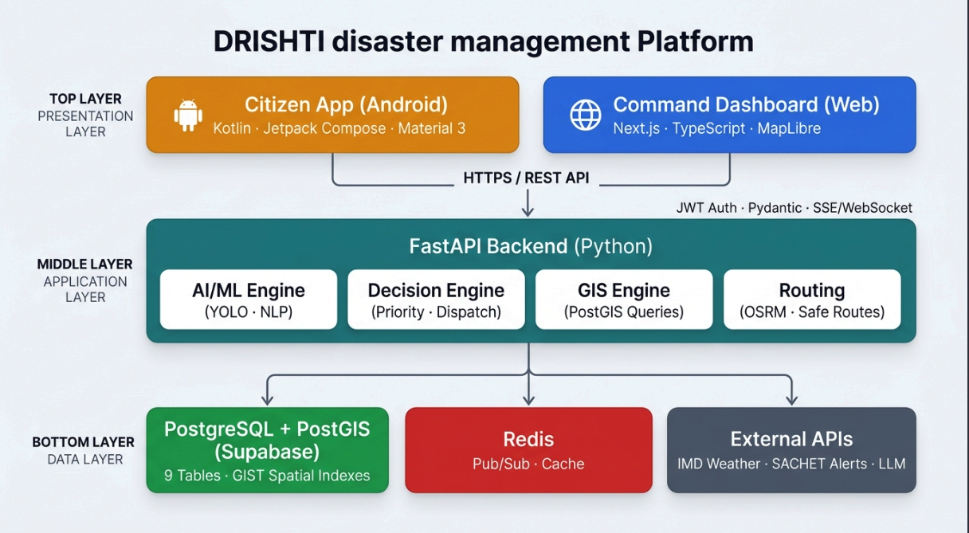
TECHNICAL APPROACH
Team Innovexis

Slide 4
FEASIBILITY AND VIABILITY
Team Innovexis
Technical Feasibility
Uses ESP32/ESP8266, drones, sensors and smartphones
Web/mobile platform integrates multiple disaster services
GPS/location can work without internet when device-level location is available
Offline communication can be extended through local wireless/mesh-based relaying.
Operational Feasibility
Citizens → SOS & receive alerts
Authorities → broadcast instructions & relief information
Rescue teams → locate and prioritize victims
Drone → acts as an emergency communication bridge
Challenge | Approach
No cellular network | ESP32 + drone-based communication
High number of victims | Priority-based SOS information
Post-disaster coordination | Centralized Lost & Found + Aid information

Slide 5
IMPACT AND BENEFITS
Team Innovexis
🚑 FOR RESCUE TEAMS
📍 Better victim location
🆘 Prioritized emergency requests
🚁 Drone-assisted monitoring
📡 Alternative communication pathway
🏛️ FOR AUTHORITIES
📢 Centralized emergency communication
🌊 Real-time environmental risk information
🏥 Relief & medical-aid coordination
📊 Better situational awareness
🌍 LARGER IMPACT
Ever Year India faces multiple disasters. Hundreds of people die because they could not be located. Many families gets separated during disaster.
Aasha Setu doesn’t just respond to disasters — it connects people, technology and authorities before, during and after them.
👥 FOR CITIZENS
Faster disaster warnings
Nearest shelter/hospital discovery
Emergency SOS even during connectivity failure
Lost & Found assistance
Post-disaster emotional support
“One warning. One SOS. One rescue. One life saved — that is our mission.”

Slide 6
RESEARCH AND REFERENCES
Team Innovexis
ESP 32 Documentation
ISRO Bhuvan
ESP-32 Documentation
Disaster management in India
Link to ISRO Bhuvan
Link
Link to documentation of Project -->
Link to Asha Setu Website -->
Link to Authority Dashboard -->

